Slide 1
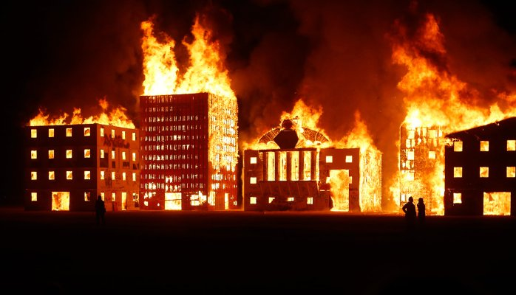
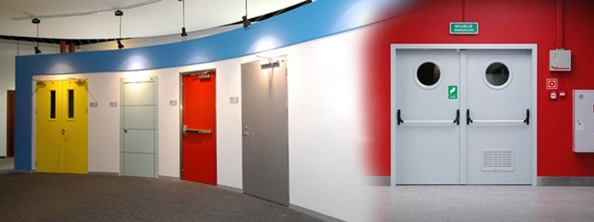
SEHGAL FIRE DOORS
A DOORWAY TO YOU
SAFETY!

Slide 2

FIRE SAFETY
Fire safety refers to precautions that are taken to prevent or reduce the likelihood of a fire that may result in death, injury, or property damage, alert those in a structure to the presence of an uncontrolled fire in the event one occurs, better enable those threatened by a fire to survive in and evacuate from affected areas, or to reduce the damage caused by a fire.
Fire safety measures include those that are planned during the construction of a building or implemented in structures that are already standing, and those that are taught to occupants of the building.
Threats to fire safety are referred to as fire hazards. A fire hazard may include a situation that increases the likelihood a fire may start or may impede escape in the event a fire occurs.
Fire safety is often a component of building safety.

Slide 3
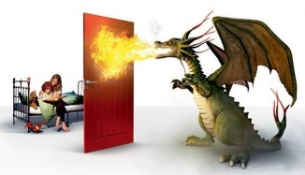
FIRE PROTECTION ENGINEERING
Fire Protection Engineering (also known as fire engineering or fire safety engineering) is the application of science and engineering principles to protect people and their environments from the destructive effects of fire and smoke.
The discipline of fire protection engineering includes, but is not exclusive to:
Active Fire Protection - Fire Suppression Systems, and Fire Alarm etc.
Passive Fire Protection –Fire Doors and Smoke Barriers, Space Separation etc.
Fire Prevention Programs
Building Design, Layout, And Space Planning
Smoke Control And Management
Escape Facilities- Emergency Exits, Staircase Etc.
Fire Dynamics And Fire Modeling
Human Behavior During Fire Events
Risk Analysis, Including Economic Factors
Wildfire Management

Slide 4
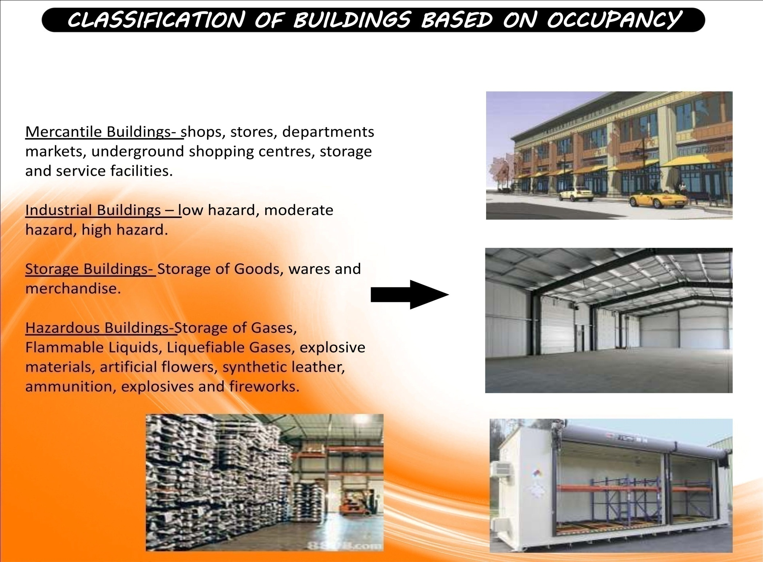

Slide 5
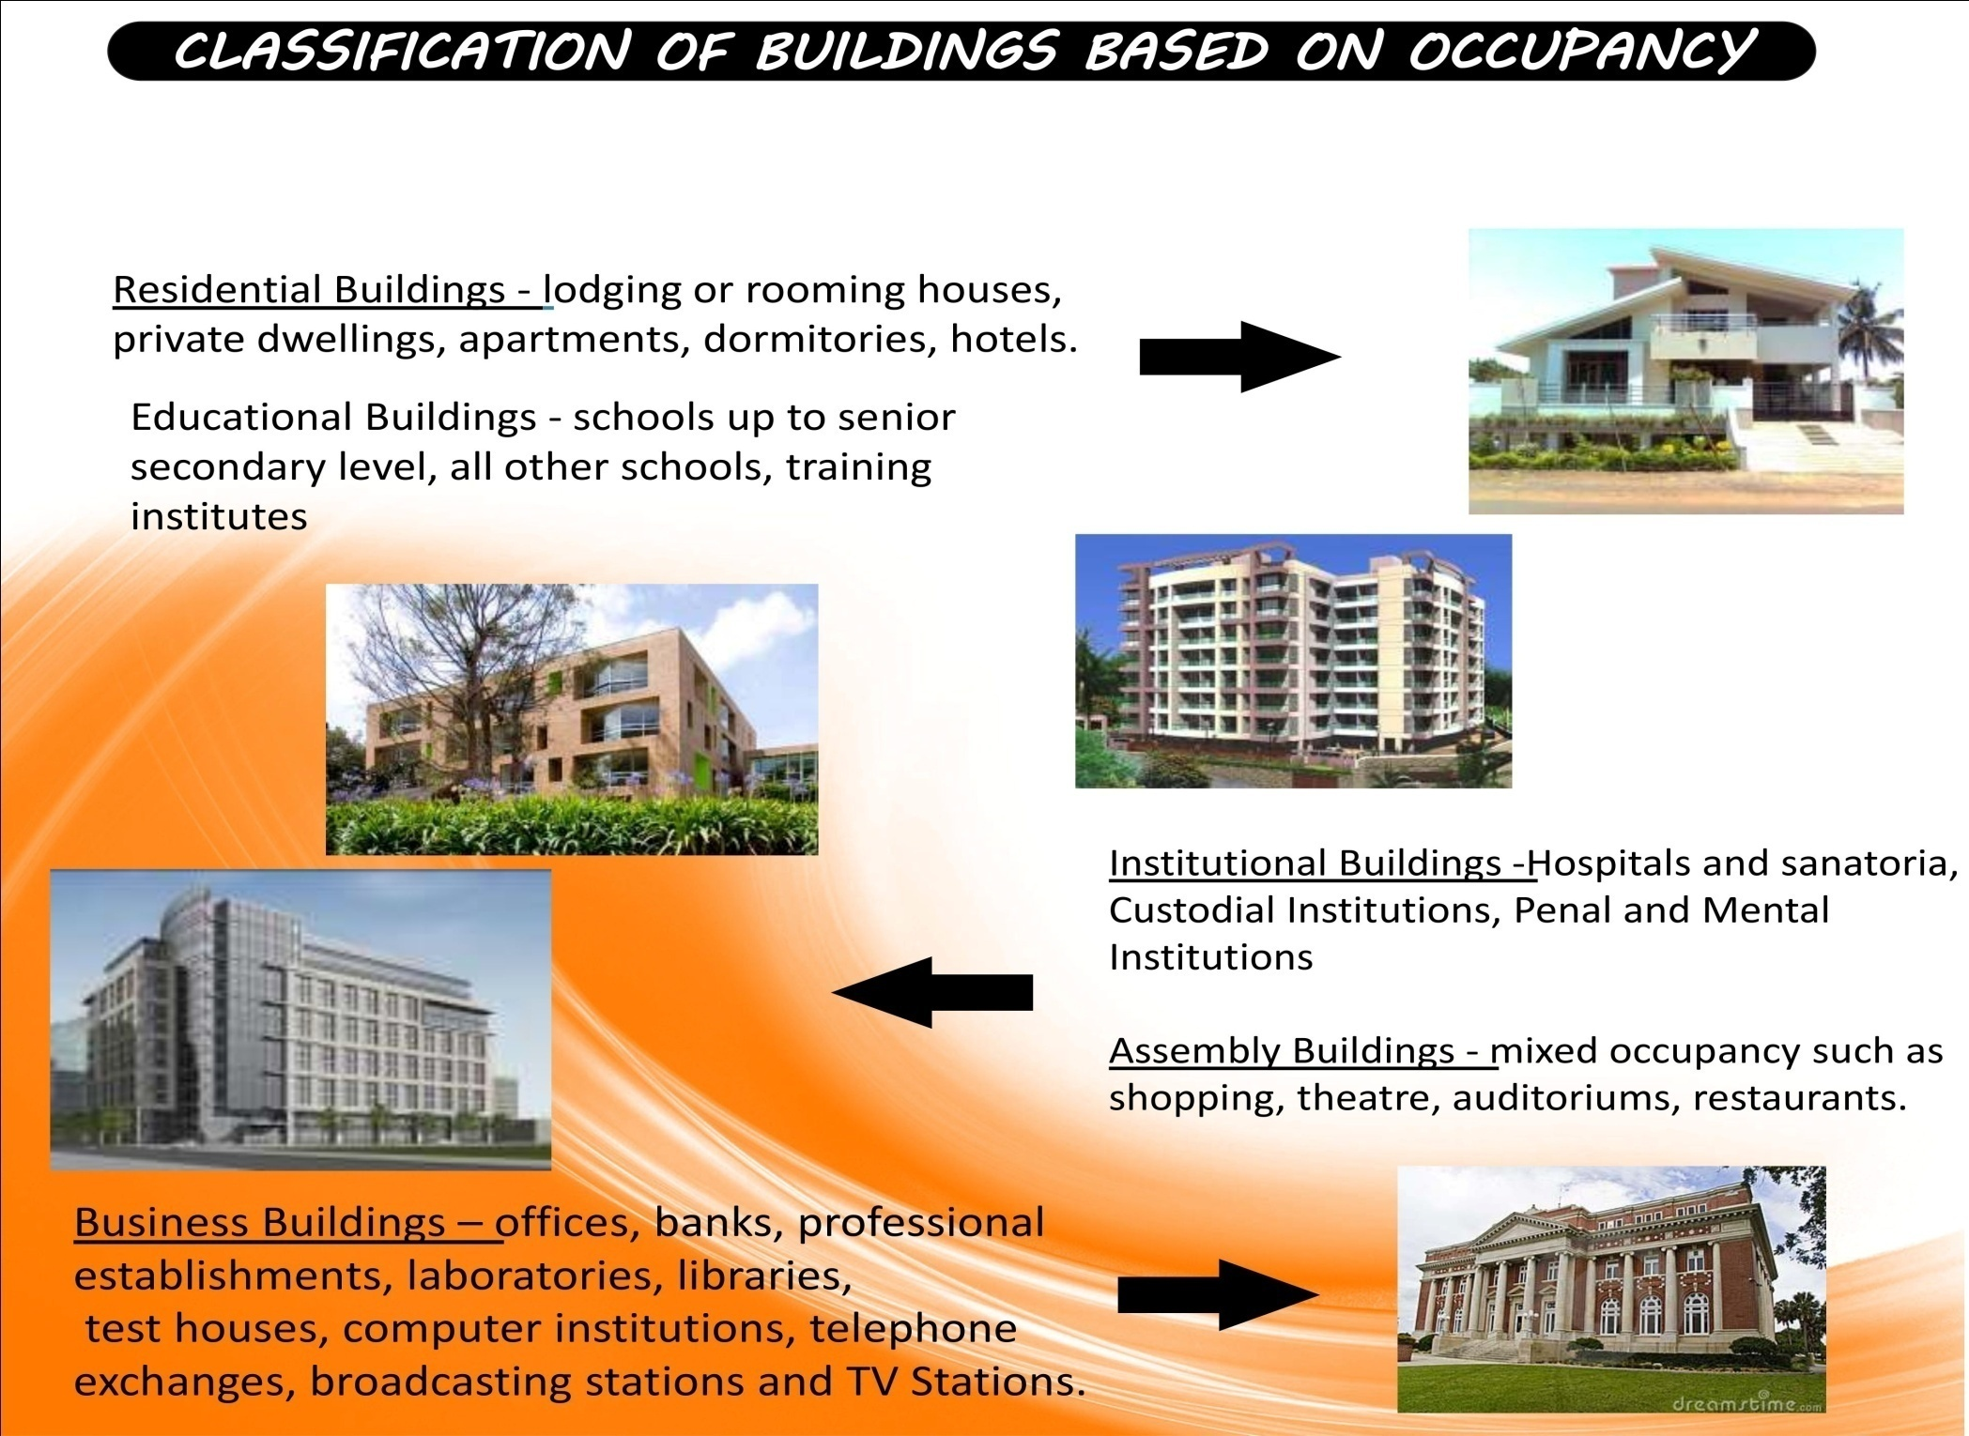

Slide 6
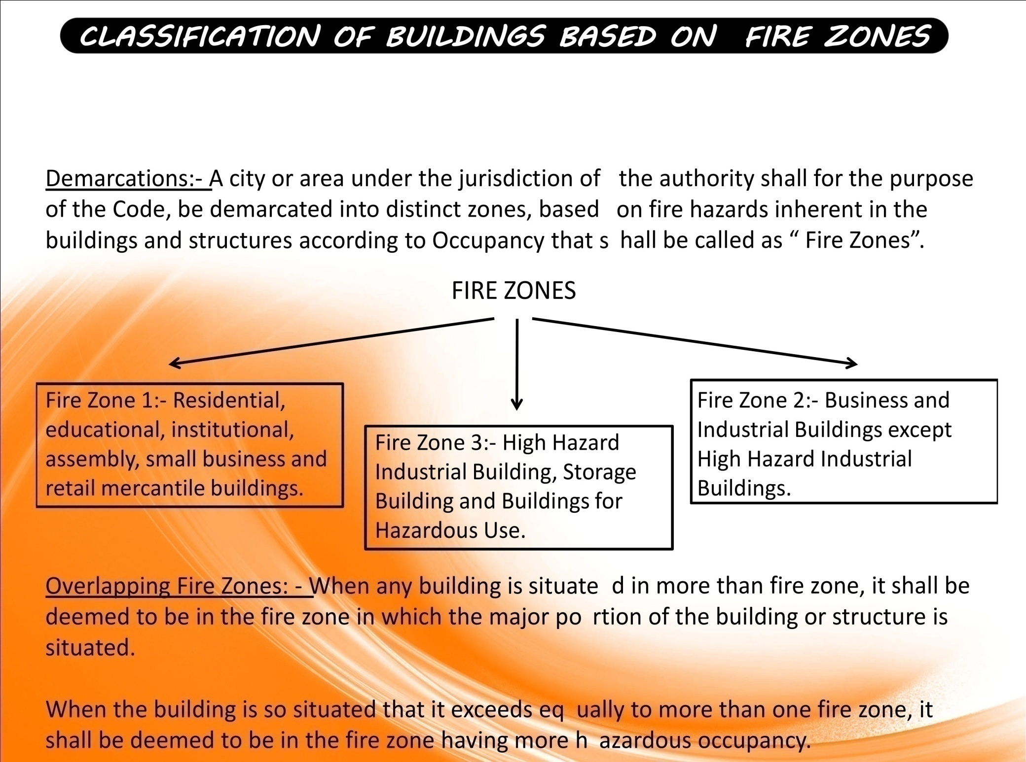

Slide 7
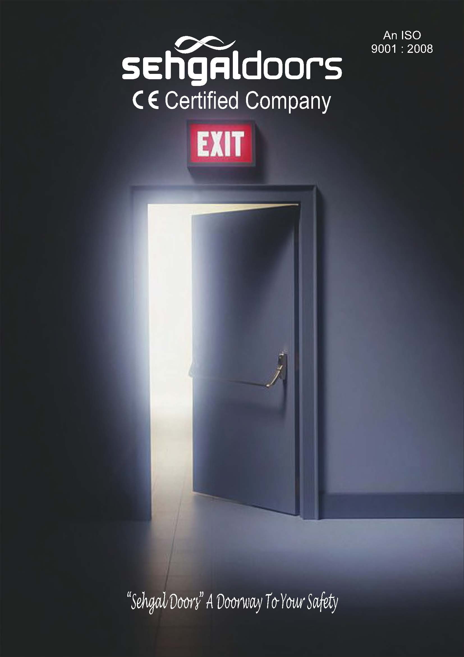

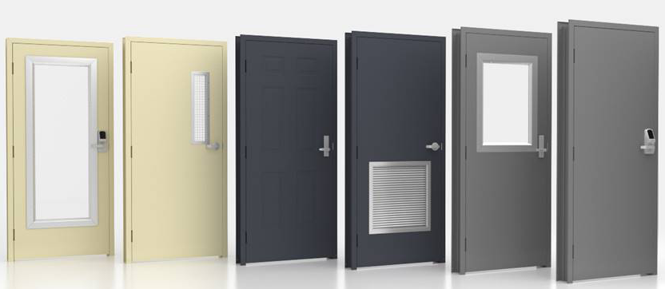
SEHGAL FIRE DOORS

Slide 8
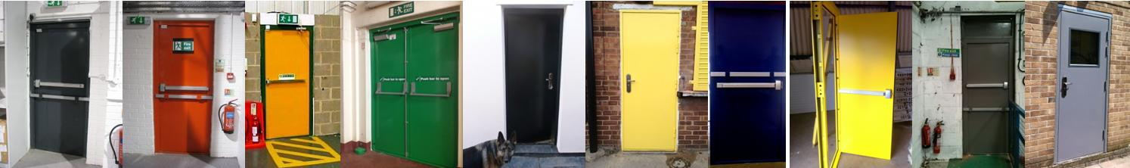
What is Fire Door?
Buildings are compartmentalized to delay the spread of fire from one area to another. These compartments are usually linked by fire doors to allow the flow of traffic around the building. Fire doors have two important functions in a fire; when closed they form a barrier to stop the spread of fire and when opened they provide a means of escape.
A well designed timber fire door will delay the spread of fire and smoke without causing too much hindrance to the movement of people and goods.
Every fire door is therefore required to act as a barrier to the passage of smoke and/or fire to varying degrees depending upon its location in a building and the fire hazards associated with that building.
The main categories of fire doors are FD30 upto FD120 fire doors which offer 30 upto 120 minutes fire protection.

Slide 9
WHERE ARE FIRE DOORS NEEDED?
As indicated above, there are two main requirements of fire doors, which prescribe their location in a building. They work together in an integrated system in order to preserve life and property through
Compartmentalizing a fire;
Creating/protecting an escape route through the building.
The escape route in a fire situation is frequently the route of everyday traffic; hence the fire doors must not obstruct the normal functioning of a building. As earlier noted, door retainers can be used to keep them legally open, although the doors should be regularly closed as part of their routine maintenance in order to prevent warping or other malfunctions that could compromise their integrity in a fire situation.
In serving to compartmentalize a building and/or preserve an escape route, the function of a fire door, when closed, is to provide resistance to smoke/fire for a minimum specified length of time. It is possible to have steel fire doors offering up to 2 hours resistance but this level of protection is usually only a requirement in specific, high-risk environments. Thirty minutes should, in most situations, allow for the evacuation of premises and response of the emergency fire services.

Slide 10
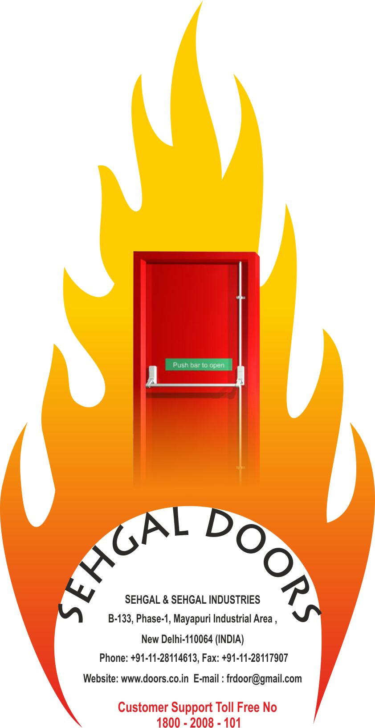
Identifying Fire Doors
Manufacturers can certify fire doorsets, both for identification purposes and to guarantee their performance in a fire situation. The first step for the manufacturer is to construct a fire doorset designed to a specification that, in their opinion, will resist a fire for a specified length of time.
This doorset will then be tested by an approved fire testing centre and, if it is passed, any doorsets constructed to that specification can be considered for certification.
Once the certification is approved, each similarly constructed doorset will be identified by a label identifying the manufacturer, the date of manufacture and the designated fire rating of the door type.
This identification label is usually affixed to the top edge of the door. A colour-coded plug may be inserted into the door, instead of or in addition to the label.

Slide 11
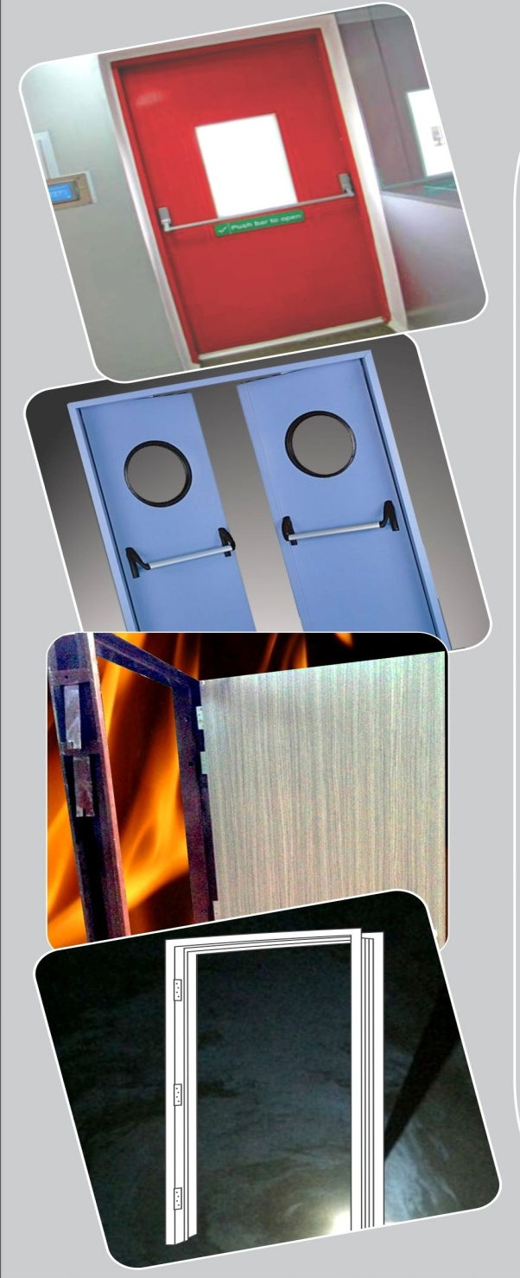
Advantages of Steel Door's
Environmentally friendly
Steel is non-combustible and won’t contribute to the spread of a fire.
Durable and safe
Recyclability
Steel doesn’t have to be treated with pesticides, preservatives or glues, so steel door houses offer indoor air quality benefits.
Energy efficiency
Termites do more damage to homes each year than any other natural disasters. The material’s higher strength contributes to safer structures that require less maintenance and last longer.
Less scrap and waste (2% for steel vs. 20% for Timber)
Steel will not rot and is immune to termites and other insects.

Slide 12
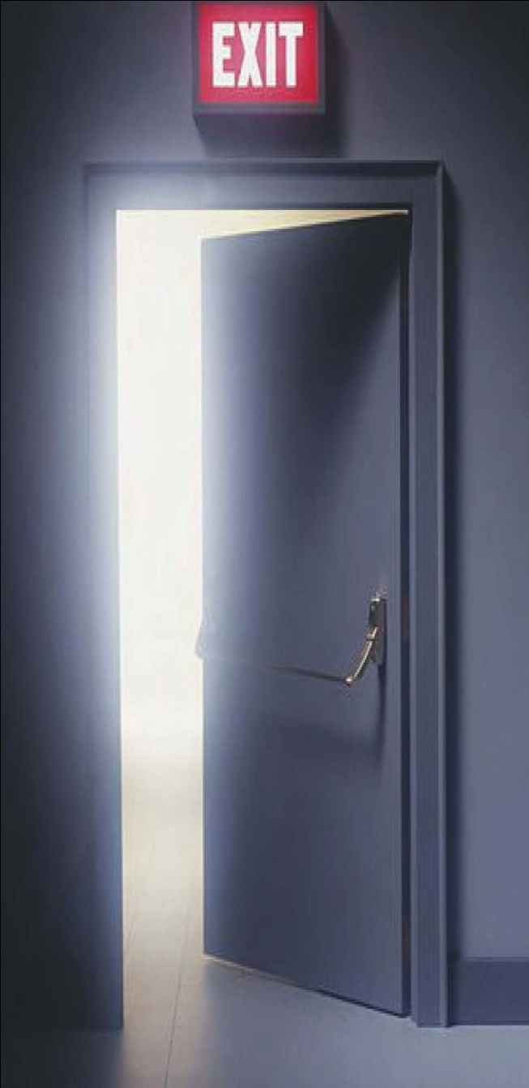
METAL FIRE DOORS
SEHGAL DOORS where Fire Doors are manufactured to meet the life people stuck at any High Rise Building or Structure with the ability to hold or stop the spread
of fire. We can proudly say that we are playing a crucial part in your everyday life & at your own personal place, to keep you protected & secure yet almost keeping our self invisible from all.
KEY FEATURES OF METAL DOORS:
Can be Manufactured from Mild Steel Sheet, Galvanized Sheet or Stainless Steel Sheet.
Fire Ratings Available - 30, 45, 60, 90,120 minutes maximum.
No welding joints and sharp edges interlocking at the stiles.
Easy to install & fix at site with the help of holdfast installed Door or through Dash Fastener.
Final finished available with zinc phosphate storing primer, polyurethane paint or powder coated as per the client’s requirement.
Tested & certified by C.B.R.I Roorkee.
Our Doors carry a warranty of 1 year against any manufacturing defect.

Slide 13
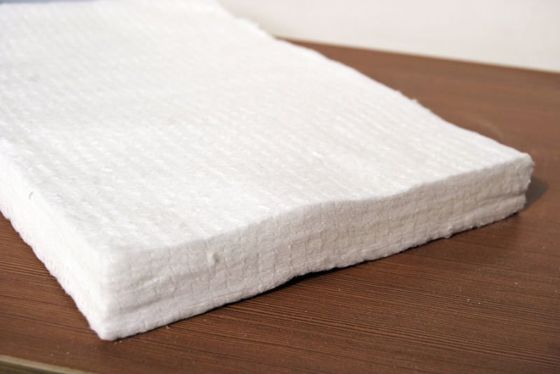
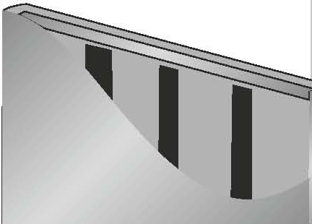
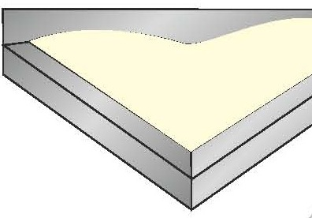
FIRE DOOR INFILL
Ceramic wool/ Rock wool : Paper with its unique properties enhances the structural integrity of the door with minimal additional weight to the door. The final finish on the door is predominantly dependent on the quality of the honeycomb Kraft and the glue which is used to get the flat surface. This infill material invariably has high crushing strength leading to impact resistance. The quality and consistent flat surface achieved because of the infill material is exceptional to the material and
design of the doors.
Steel stiffened doors : Used for exterior applications, these doors are known for their rigidity and are available in varying strength and quality while the thickness of the stiffeners can vary. We offer stiffeners of 20 gauge galvanized steel. Spacing
between stiffeners may vary from 4" to 6". They are welded to each other at the top and bottom and to the inside door skin. The cavities are filled with special core. For temperature rise doors, all cavities are filled with mineral rock wool.
Polyurethane foam: It is used as an insulator and provides complete surface support, impact resistance and exceptional thermal resistance. It offers the lowest “ ” value (approx. 0.09) and the highest “ ” factor (approx. 11.1). This core has certain
limitations on application and fire rating of the door. Not recommended for use on BS / IS fire Doors.

Slide 14
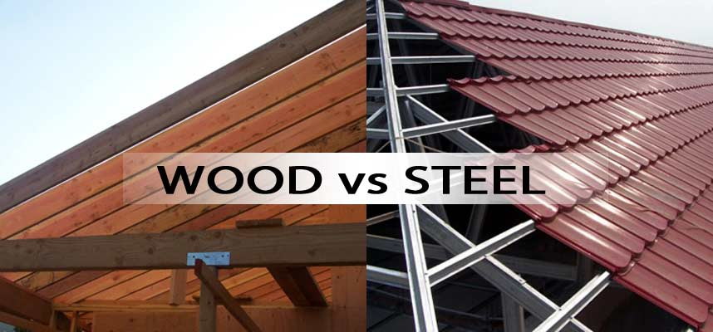
S.no | Wooden Fire doors | Hollow Metal Fire Doors
1 | Wooden fire rated doors are not recommended for fire ratings of 60minutes and above as per the international standard also. | Hollow metal fire doors are used where ever the fire rating required is more than one hour.
2 | For all wooden fire doors the provision for door hardware has to be factory finished and fitted as a assembly to ensure the required rating and guarantees. However it is not followed in our working conditions and left to the installer at site. | All provision is factory prepped and consistent throughout the building.
3 | The minimum door thickness recommended is 60mm. | The minimum door thickness is 44mm.
4 | Requires high level of maintenance as the wood being an organic material always tends to contraction and expansion. | Tested and proven for all kind of usage and application in different climatic conditions.
5 | The wooden fire rated requires intumescent seals and fire retardant paints as a protection material. | Hollow metal fire door does not require any intumescent seals as the product test criteria because of the material being steel.
6 | The quality of wood may not be consistent throughout the building and hence the relevant performance. | The consistency on the material is assured as the base material is steel.
7 | Can generate Toxic gases if the core or the surface material is not appropriate. | A hollow metal door does not emit any gases or smoke, but seals the gaps because of the expansion of the door.
8 | Wooden fire rated doors are not consistent on performance and hence the core used plays a vital role. | Hollow metal fire doors are design oriented and are not infill specific.
9 | There are limitations on door sizes and vision glass as the rating goes beyond 60minutes. | There is no limitation on the door widths and heights. Vision glass can be supplied within the test parameters.
10 | All hardware provisions need to be protected with intumescent strips as the material rigidity is lost due to cut-outs on the door leaf. | The same is not relevant in the case of steel doors.
11 | True wooden fire doors are very expensive because of the core. | When compared to wooden fire doors it is economical and cost effective.
12 | Limited finishes. | Can offer any finish or RAL colour.

Slide 15
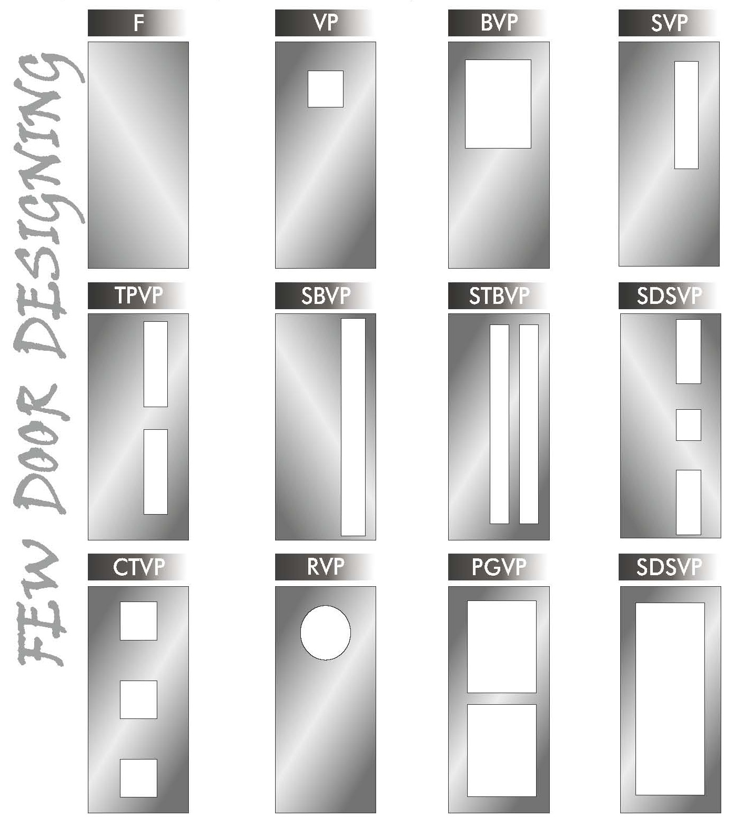

Slide 16
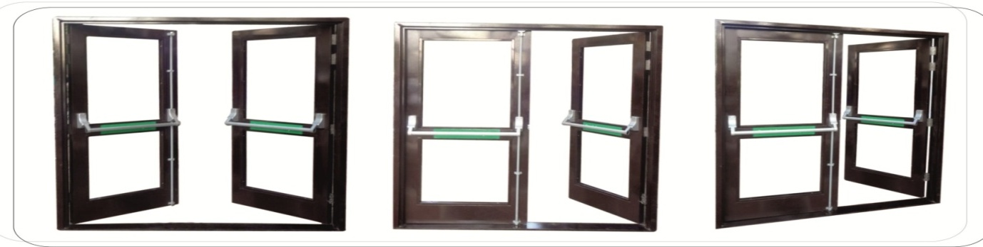
GLAZED RATED FIRE DOOR
Providing fire resistant door frame of section 143 x 57mm having built in rebate made out of 16 SWG G.I sheet (zinc coating not less than 120 gm/Sqm) duly filled with vermiculite based concrete mix, suitable for mounting 60 min fire rated door shutters. The frame is fitted with intumescent fire seal strip of size 10x4mm (minimum) all-round the frame & fixing with dash fasteners of approved size & make, including applying a coat of approved brand fire resistant primer etc. complete as per direction of Engineer-in-charge (Dash fasteners to be paid separately)
Providing 50 mm thick glazed fire resistant door shutters of 60 min fire rating conforming to IS:3614 (Part - II), tested & certified as per laboratory approved by Engineer-in-charge, with suitable mounting on door frame, consisting of vertical styles, lock rail, top rail, 100 mm wide, bottom rail 200 mm wide, made out of 16 SWG G.I sheet (Zinc coating not less than 120 gm/m2) dully filled FR insulation material with necessary stainless steel ball bearing hinges of approved make , including applying a coat of approved fire resistant primer etc. complete as per direction of Engineer-in-charge (panelling to be paid separately.)
Providing glazing in fire resistant door shutters, fixed panels, ventilators & partitions etc., with GI beading of appropriate size, made out of 20 SWG G.I sheet (zinc coating not less than 120 gm/m2). Fire resistant sealant, including applying a coat of approved fire resistant primer on GI Beading etc., complete all as per direction of Engineer-in-charge.
With clear fire resistant glass panes 6mm thick of approved brand, having minimum 60 min fire resistance.
Providing panic bar/latch (Double point) fitted with a single body, Trim latch & lock on back side of the Panic Latch of reputed brand and manufacture to the approved by the Engineer-in-charge all complete.

Slide 17
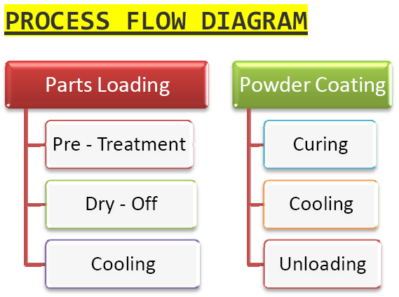
POWDER COATING AS PER IS: 13871 (1993)
Advantages to Using Powder Coating
1. Powder coating can produce coatings without running or sagging.
2. Painting process can be shortened because setting is not needed after coating.
3. Powder coating process is simple.
4. Adhered coating produces 100% film of paint.
5. Depending on the process, powder coating can produce film of 40?m – 50?m thickness.
Powder coating process reduces hazardous waste, prevents poisoning, and occurrence of fire by not requiring solvent to keep the binder and filler part in a liquid suspension form.
Storing and managing is easy because the paint is in the powder form and emits zero or near zero volatile organic compounds (VOC).
Powder Coating Process
Powder coating uses only 100% powder.
Powder coating can continuously spray uniform film coating
of about 80 meters.
Powder coating is economically for efficient.
Advantages to Powder Coating
Strength of the painted area is strong.
Creates smooth surface.
Does not peel off easily.
Strong adhesive.
Increased paint efficiency by removing bond coating.
Has a graceful appearance.

Slide 18
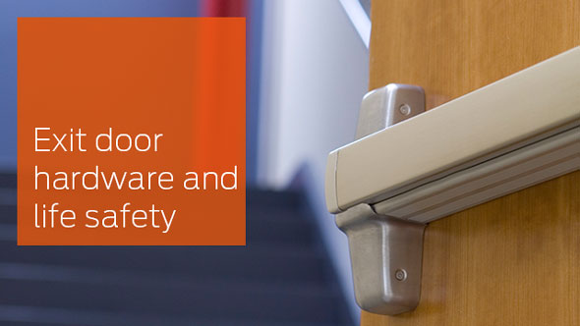

Slide 19
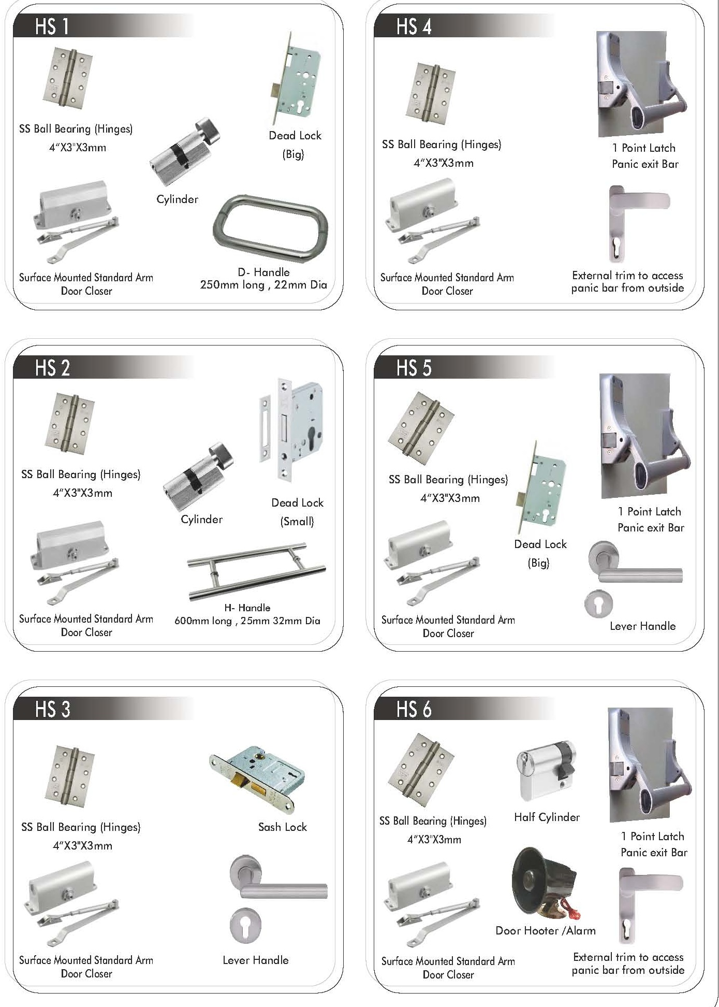

Slide 20
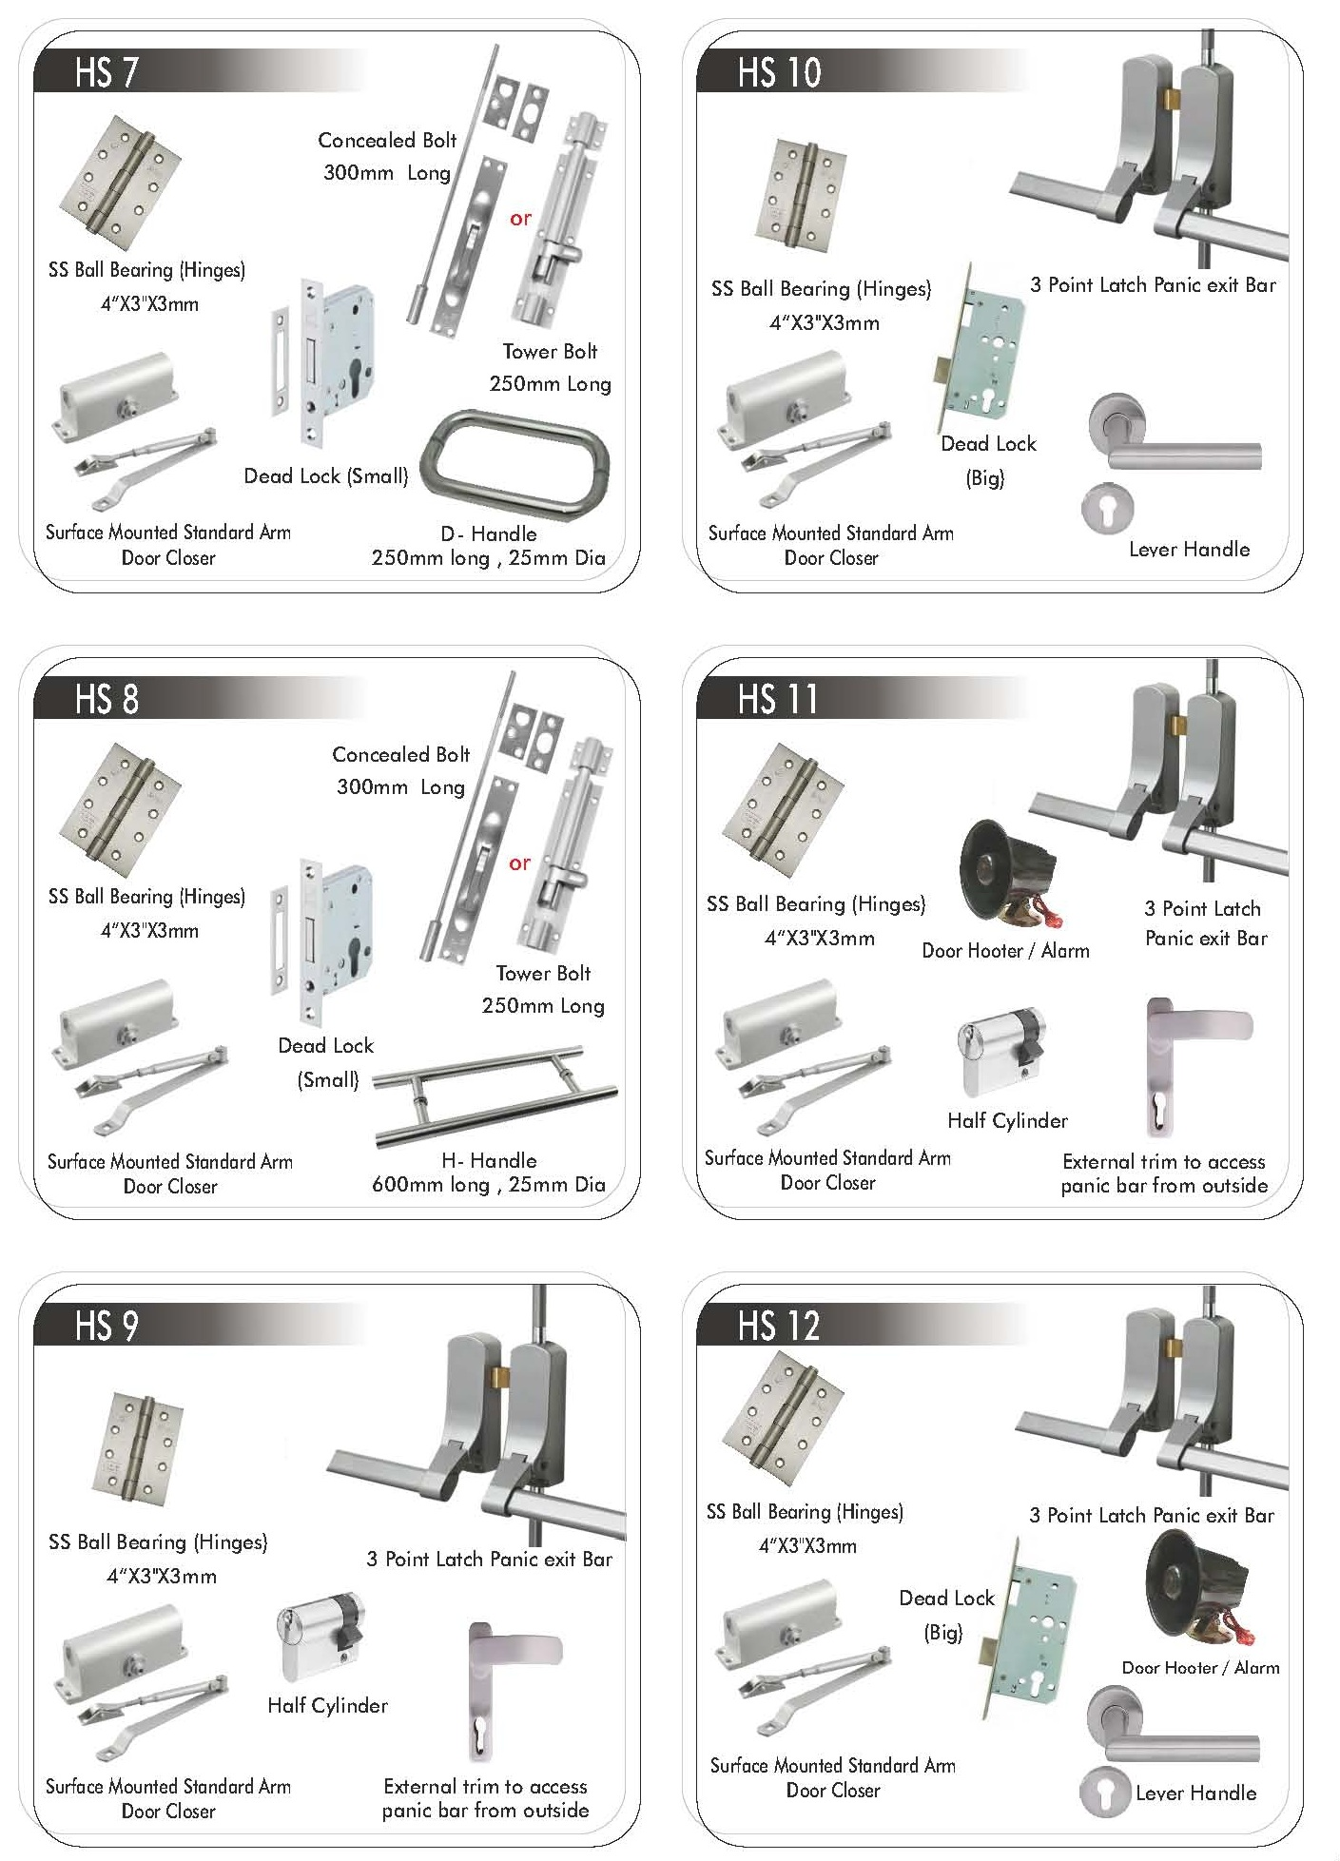

Slide 21

FAQ – FREQUENTLY ASKED QUESTIONS
Q: Why I should select steel door frames and shutters over wooden one?
A: Good quality wood is not available in our country. Apart from that, cutting of wood is now banned as it leads to deforestation and ultimately we lose our ecological balance. Steel is the safest and easily available material in our country. Steel door frames/shutters can be fabricated in any size and finish. Even, we can offer you steel door frames / shutters in wood finish also.
Q. Is it easy to fix steel door frames / Shutters?
A. Yes. Any technician can install steel door frames / shutters with holdfast else we provide them with fastener provision as well.
Q: Can I fix any kind of handles and locking system on steel door frames and shutters?
A: Yes. Any kind of lock and handles can be fixed on steel door frames and shutters. We are also flexible in providing hardware provision as per the Hardware shared by the client.
Q: Is it maintenance free?
A: Yes. Steel door frames/shutters are totally maintenance free. They can withstand in any weather condition compared to Wooden Doors.

Slide 22
FAQ – FREQUENTLY ASKED QUESTIONS
Q: Can we change the original finish of frames?
A: Yes. You can repaint/spray finish the frames when needed.
Q: Can you give wood finish to door frames/shutters?
A: Yes. We can give wood finish to door frames/shutters.
Q: What is the speciality of Sehgal Doors Products?
A: Being machine made (on CNC Machines & Turrent) quality and cutting of products is far superior compared to any other product.
Q: Can we use your products in green building?
A: Yes. Our products are suitable for green building.

Slide 23
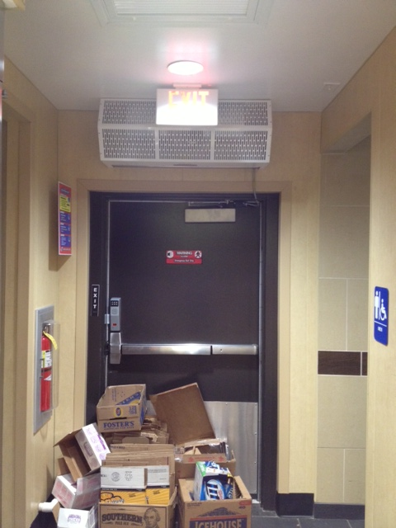
Exit Doors Must Be Unlocked
Everyone must be able to open exit doors from the inside at all times
  without keys, tools, or special knowledge
  may be locked from the inside only in mental, penal, or correctional facilities where there is constant supervision
Device such as a panic bar that locks only from the outside is permitted
Must be free of any device or alarm that could restrict emergency use if the device or alarm fails.

Slide 24

Importance of Safe Exit Routes
Factors that may interfere with safe escape include:
  Panic
  Confusion
  Poor visibility
  Lack of information
  Misinformation
These factors frequently cause more injuries and fatalities than the hazard itself
Be prepared
Exit routes must be:
  Free and unobstructed
  Free of explosive or highly flammable materials
  Arranged so that employees will not have to travel toward a high hazard area, unless it is shielded
Emergency safeguards must be in working order at all times sprinkler systems, alarm systems, fire doors, exit lighting, etc.

Slide 25
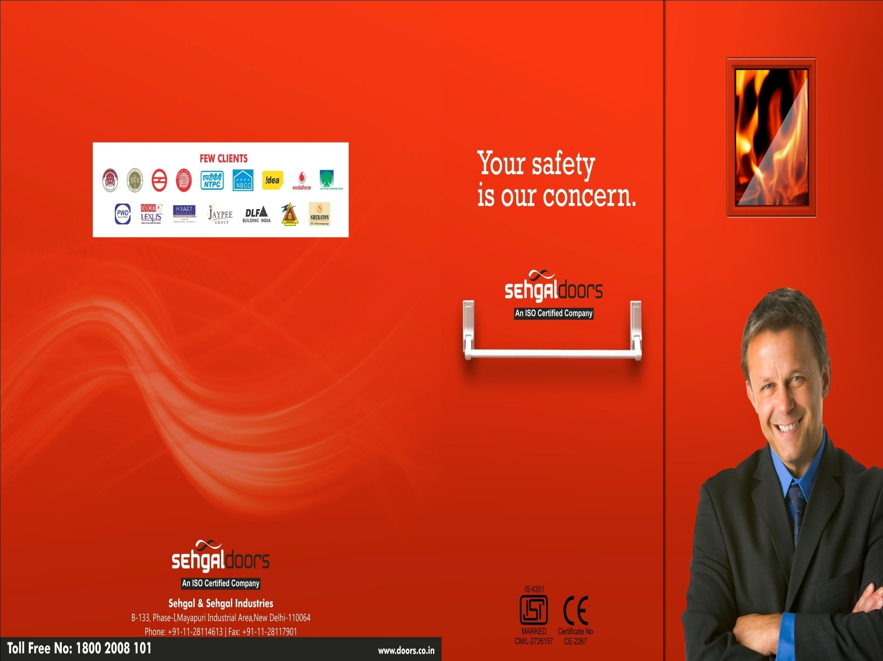

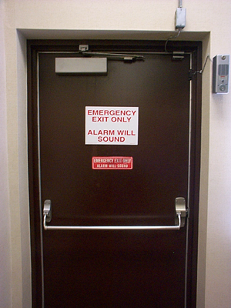

Exit Marking
Each exit must be clearly visible and marked with an “Exit” sign
Each exit must be free of decorations or signs that obscure the visibility of the door
The line-of-sight to an exit sign must clearly be visible
If the direction of exit travel is not immediately apparent, signs must be posted indicating the direction to the nearest exit
Doors along an exit route that could be mistaken for an exit must be marked ”Not an Exit”, or be identified by a sign indicating its actual use (e.g. closet)

Slide 26
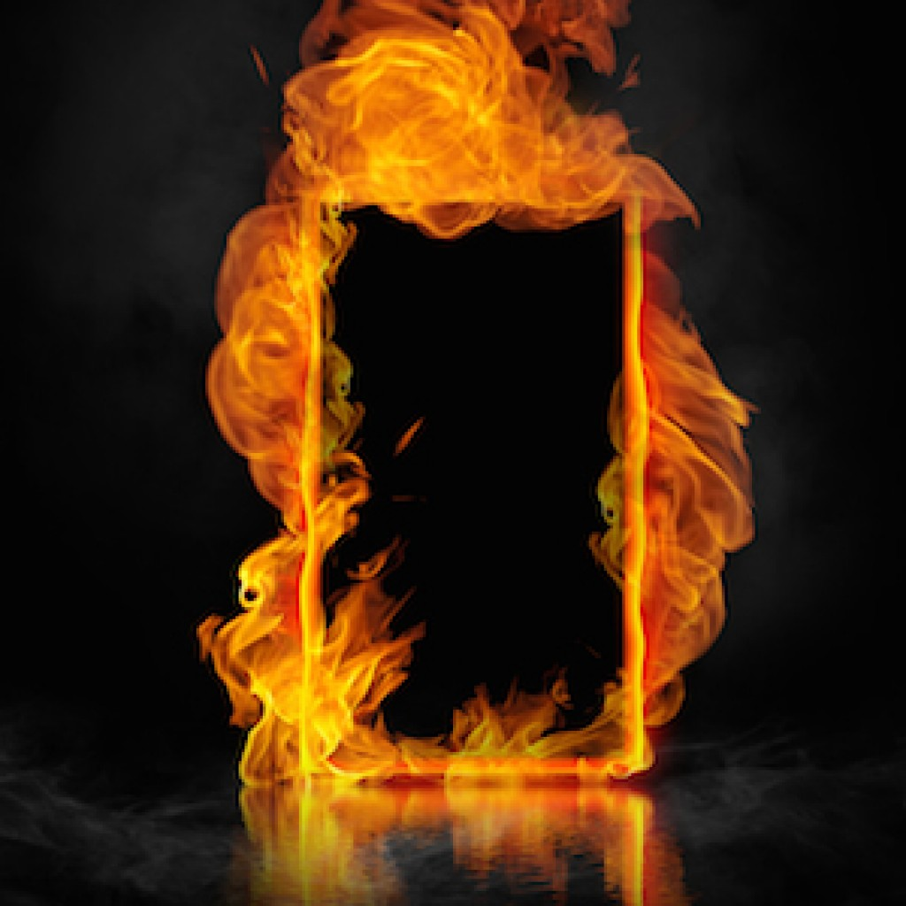
Maintenance of Fire Doors
Fire doors are engineered products that provide life and property saving functions in the event of fire. It is important that they are regularly inspected and maintained to permit them to perform at their best on the one and only occasion when they are called upon to do so.
Doorsets fitted with hold open devices or swing free type closers should be closed daily, particularly overnight when there is likely to be low building occupancy. For busy 24/7 buildings (e.g. hospitals) fire doors should be closed at least weekly. All fire doors should close effectively from any angle of opening, using only the door closer.
There are a number of reasons why doors may fail to close:-
Foreign bodies or other objects may be obstructing the door.
The smoke seals may be incorrectly fitted or damaged.
If a latch is fitted, it may be malfunctioning or require lubrication.
The closing device may need adjustment but this must only be done as a last resort and very carefully, to ensure that the door can be opened without undue force.
Intumescent seals should be checked regularly, at intervals not greater than 6 months, and damaged or missing ones replaced. To maintain the designated performance potential, replacement seals should be of the same brand, size and type as the original. Any intumescent seal of the same size as the original, however, is better than none. The gap between the fire door and the frame should be 2 to 4mm wide.

Slide 27
Maintenance of Fire Doors
Mechanical items such as hinges, locks, latches, closers, floor springs etc are likely to wear over time. Maintenance provisions should comply with the hardware supplier’s recommendations where these are known. Otherwise, locks and latches may require occasional light lubrication.
Some hinges use self-lubricating bearings that will not need additional lubrication.
Where it is necessary to replace worn hardware on a fire door, the essential items should be replaced with products to the same specification as the original where possible. Otherwise, hinges, latches, locks, flush bolts, closers and other items of load-bearing or securing hardware should be of the same type and size as the original items and should have been proven for use in timber fire rated doorsets of the required performance.
Hardware that has been successfully tested in metal doorsets may not be suitable for use with timber doorsets. Intumescent gaskets may have been used under hinge blades, locks/latches for end plates, strike plates, and/or with closer fittings and in flush bolt recesses. These gaskets should ideally be replaced if possible with gaskets of the same material; alternatively, if undamaged, they should be retained and reused with the new fittings. Intumescent gaskets or mastics used for these applications are usually the low pressure type.

Slide 28
ANY QUESTION ?

