Slide 1

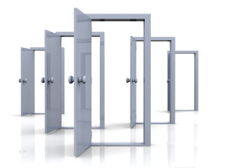


Quality from start to Finish!!

Slide 2
IN BUSINESS SINCE LAST 55 YEARS!!
The reasons for our meteoric growth is not difficult to guess. As a
Family - owned entity, we have always been able to customize our
service to our clients’ product requirements. We bend backwards to
accommodate their needs.
We partner with them, every step of the way in manufacturing doors
that are unmatched in:
Elegance
Strength
Utility
Design
Creating new benchmarks, an exciting range of products and watching
the finished doors being installed - bring the highest level of
satisfaction in our team of engineers, designers and door craftsmen.

Slide 3
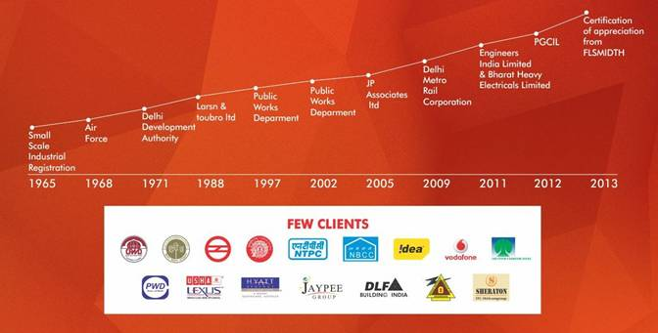
do your work in SILENCE. and let SUCCESS speak volumes for you!!

Slide 4
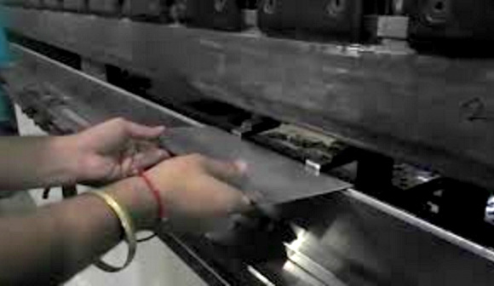
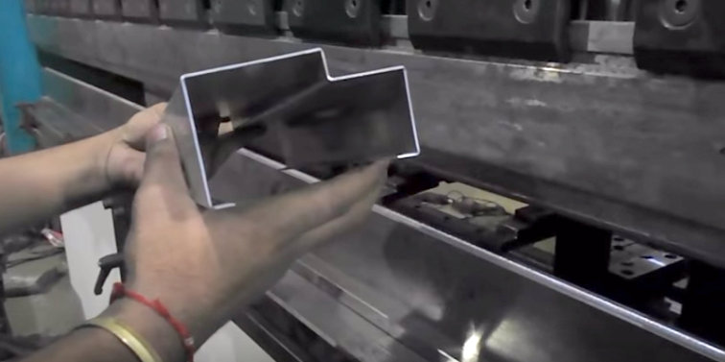
INTRODUCTION
We are engaged in the Manufacture and Supply of a superior range of Steel Door Frames that is constructed from pressed steel sections made on computerized numeric controlled brake press to provide better surface finish, consistent quality, dimensional, accuracy and high strength. This range of Steel Door Frames is far better compared to the traditional wooden door frames and puts a check to the level of forest degradation. We offer these attractive Steel Door Frames to architects, developers and builders that are seeking suitable cost efficient alternatives to be used in the construction process
Salient Features :
Do not twist or warp
Remain perfectly true and square
Eco-friendly
Economical
Structurally Load Bearing
No fear of termite
Rust resistant
Unmatched durability
Beauty in simplicity
Excellent quality
Compatible to any type of wooden or metal doors

Slide 5



PRODUCTS AVAILABLE WITH BELOW STANDARDS!!
ISO 9001:2008
CE Marked
BS Standards
IS Standards
Fire Doors approved by Dept. Of Industries and Commerce, Haryana

Slide 6
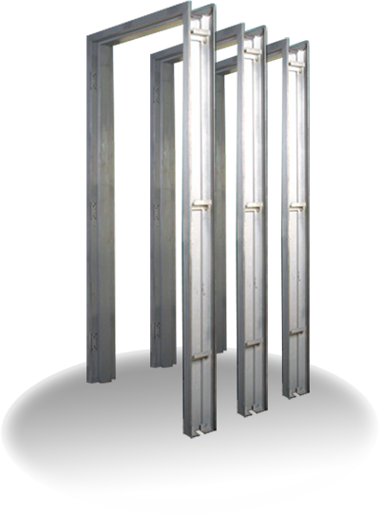
Pressed Steel Door Frames
Nowadays windows and door frames are mostly used in commercial and offices complex, high class buildings to give architectural view to enhance the beauty and smooth working.
These frames give beautiful looks less maintenance cost and are free from termite attack, rusting problems.
With the scarcity & high price of wood, these door and window frames are used.
S.no | Issue | Remark
1 | What we Give? | Govt. Approved Pressed Steel Door/Window Frames
2 | Standard | As per IS: 4351
3 | Type of Sheet | Mild Steel or Galvanised Iron Sheet.
4 | Gauge available | 14 – 18 G
5 | Pattam/Rebate | Single Rebate ,Double Rebate or Tripple
6 | Finish | Red Epoxy Primer/ Paint/Powder coated
7 | Hinges | Screwed, welded or slot cutting.
8 | Fitting | All types and per our client requirement.

Slide 7
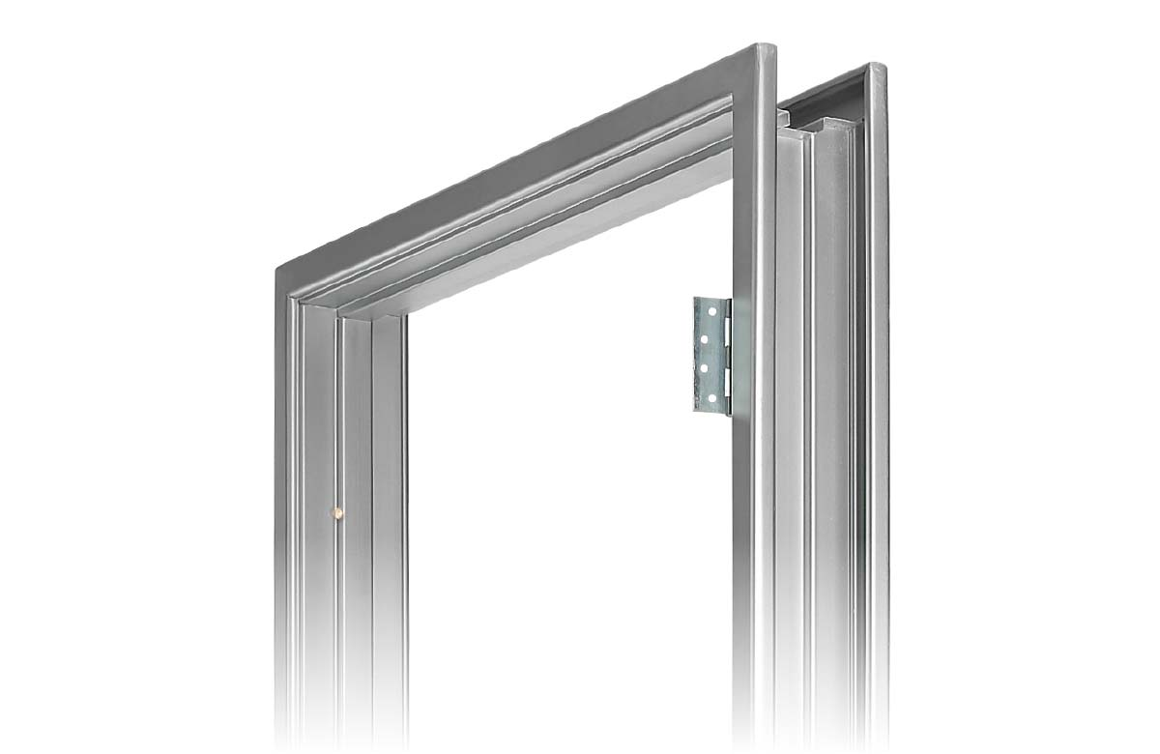


Specification
Pressed steel frame profiles are as per INDIAN STANDERED IS: 4351
Encouraging door frames made with rust-resistant 1.25/1.6 mm thick sheet
Finished with red oxide zinc chromate primer
Rubber buffers to absorb metallic sound
Mortise lock provision
Mortar guards
Hinges are mortised in a cut out on a 4mm MS Plate
Standard hot rolled tube section with 62-mm face for window shutters
Safety bars of 10 mm square bar at approx. 100-mm centres finely penetrated after punching, so no visible welding marks
Saw butt welded and ground smooth
Bolted connections to be fitted in field

Slide 8
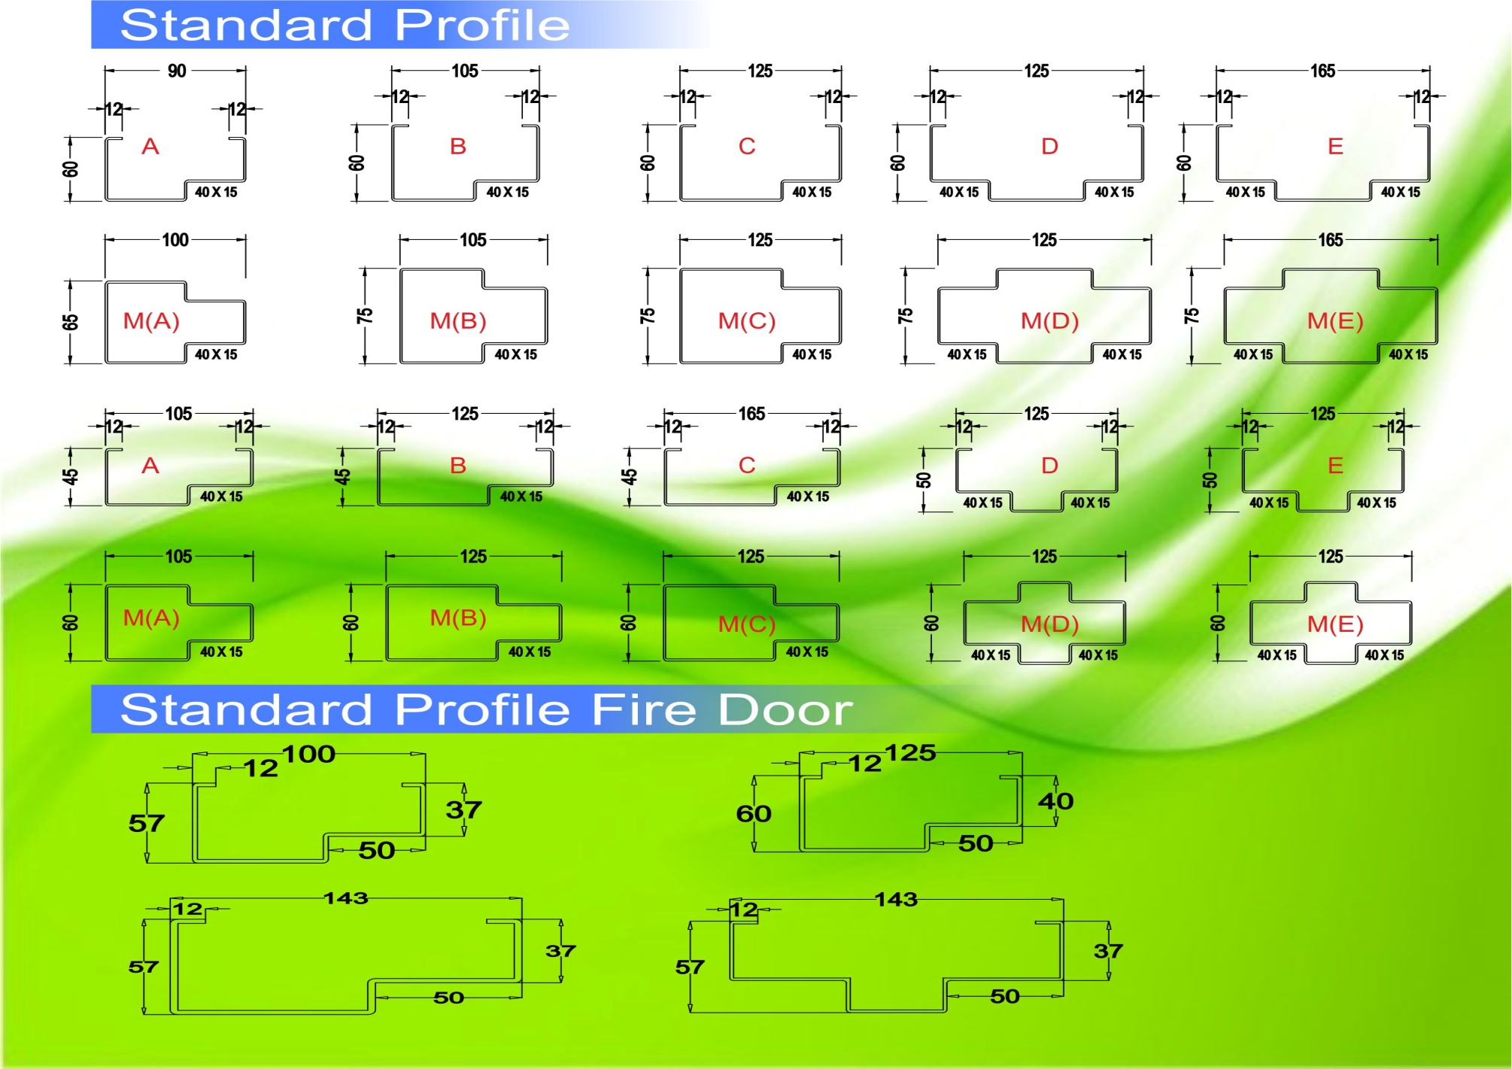
Types Of Profiles Available !!

Slide 9
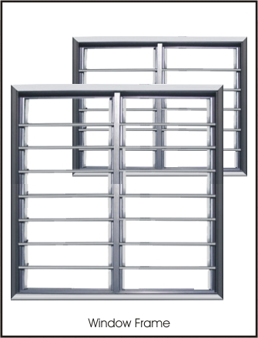
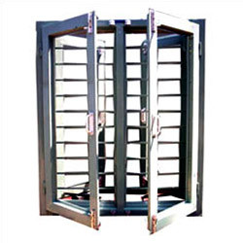
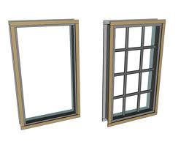
Pressed Steel Window Frames
To add the beauty of your office and residential houses one can prefer for the press steel window. It enhances the beauty of your house, it gives you 100% opening. Attractive Wooden Look. It can be both openable and sliding type.
The main advantage which it has is the security. These frames or windows give beautiful looks less maintenance cost and are free from termite attack, rusting problem.
WHAT WE OFFER:
Frame: G.I & MS Section used 100 x 50 x 16swg.
Panel: G.I & MS Section used 50 x 25 x 18swg.
Plain Glass – can be arranged on site.
Guard Bar – 10 mm
Finish: Red Epoxy Primer/Paint/Powder Coated
Fitting: can be as per client requirement.

Slide 10
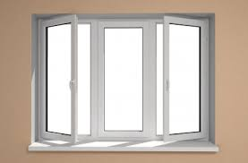
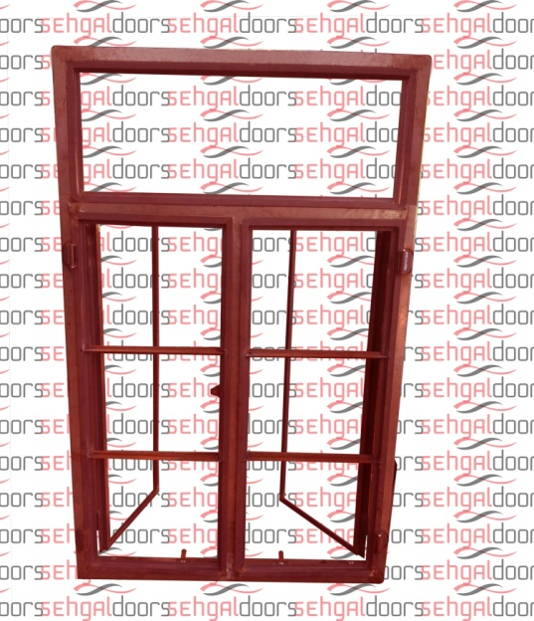
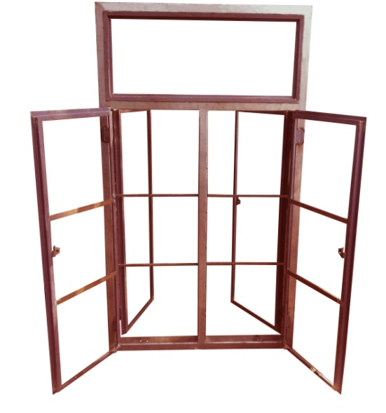
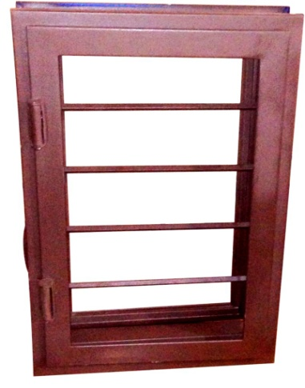
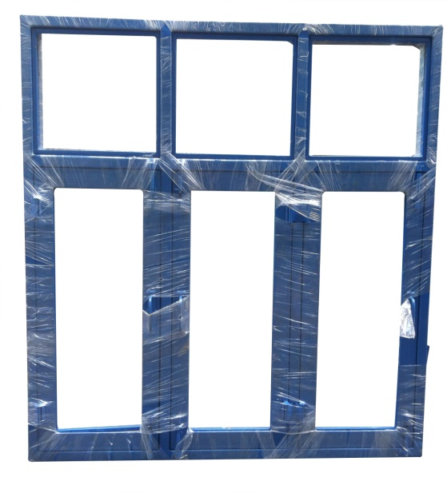
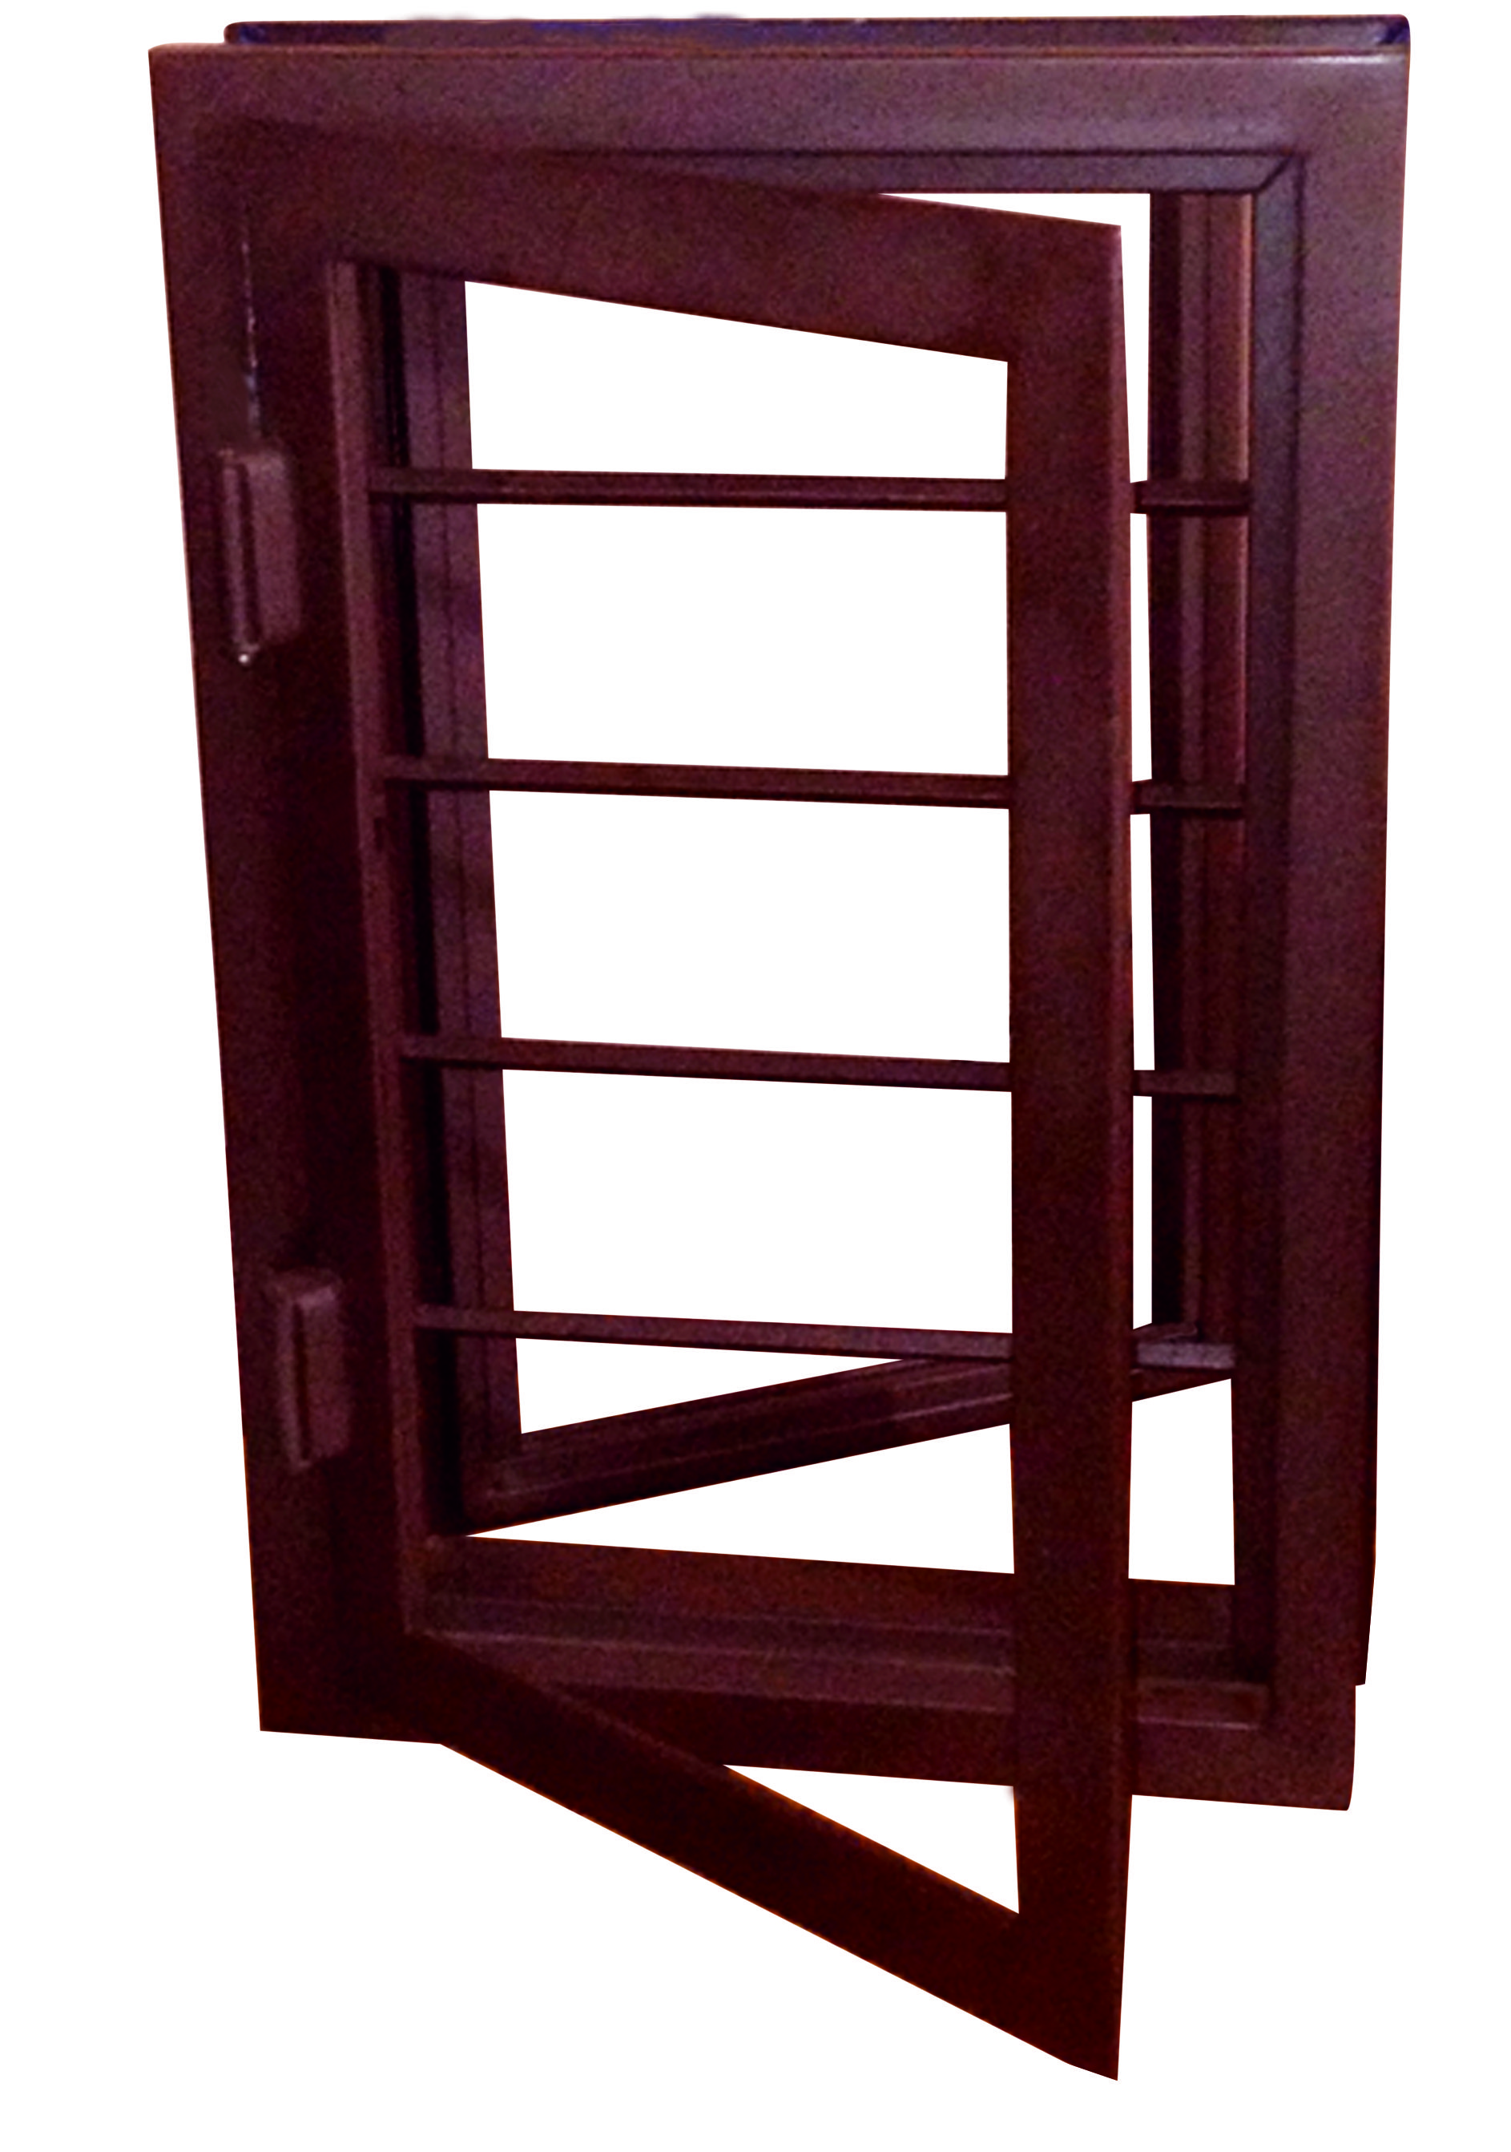
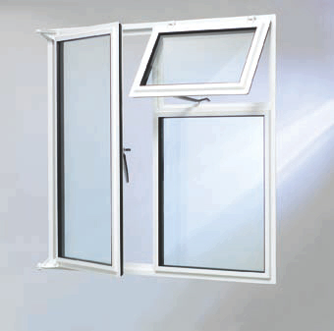
Few Samples !!

Slide 11
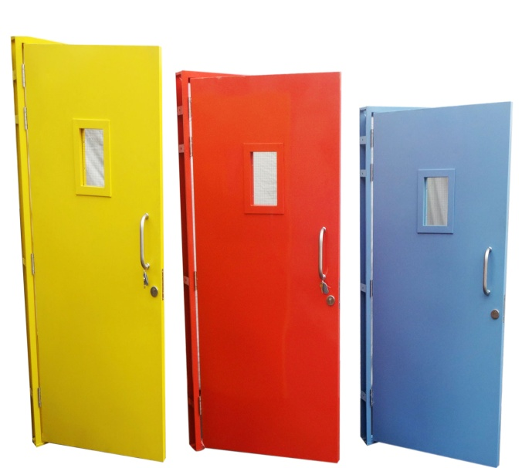
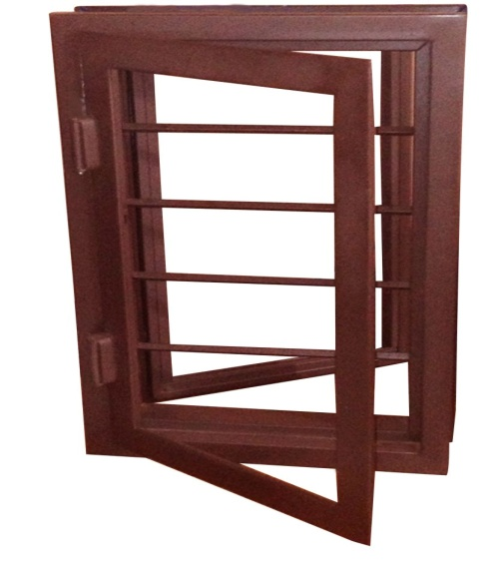
Advantages of Steel Doors & Windows!!
Environmentally friendly
Recyclability
Energy efficiency
Durable and safe.
Steel will not rot and is immune to termites and other insects.
Steel is non-combustible and won’t contribute to the spread of a fire.
Steel doesn’t have to be treated with pesticides, preservatives or glues, so steel door houses offer indoor air quality benefits.
Termites do more damage to homes each year than any other natural disasters. The material’s higher strength contributes to safer structures that require less maintenance and last longer.
Lower weight reduces risk of wall break.
Stronger connections resist earthquake movements and high winds
Straight walls and square corners mean windows and doors open and close as they should
Less scrap and waste (2% for steel vs. 20% for lumber)
Lower builder’s risk insurance costs
Less expensive for home owner’s insurance. Higher re-sale value.

Slide 12
Steel Doors v/s Wooden Doors
STEEL DOORS
WOODEN DOORS
ADVANTAGES
Lower Maintenance
No Cracking or Bowing
Less Expensive
Energy Efficient
Good Insulating Value
Secure
Available with wood grain finish
LIMITATIONS
Paint chipping can be common
Conduct temperature; cold or hot to the touch.
ADVANTAGES
Warm feel and touch
Beautiful wood grain finish only.
LIMITATIONS
Expensive
Absorbs Moisture
Can peel or Bubble out
Can bow, warp or twist
Will Fade
Not energy efficient
Requires regular Maintenance

Slide 13
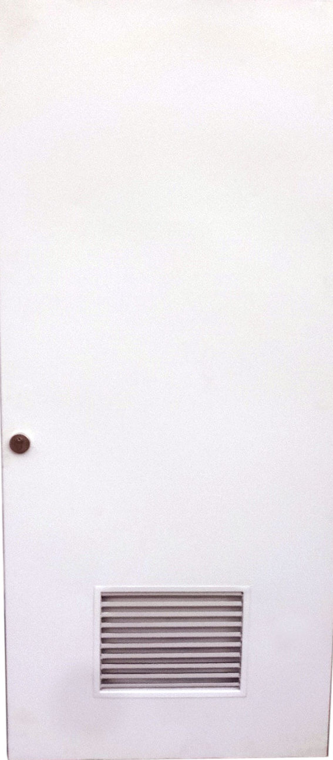
Ventilator
Ventilated Door are the latest doors in the market which enables the beauty of your hall or drawing room as it adds to the beauty of Bunglow. It facilitates proper ventilation as it carriers lowers for the purpose.
It not only gives ventilation but also security without affecting sunlight and air. It helps to retain the freshness of the room.
WHAT WE GIVE: (STANDARD)
Frame: 100 x 50 x 16swg.
Shutter: 18swg, 46 mm thickness.
Ventilator Panel : Lower System
Finish: Paint/Powder coated Finish.
Fitting: As required by the client.

Slide 14
FREQUENTLY ASKED QUESTION
Q: Why I should select steel door frames and shutters over wooden one ?
A: Good quality wood is not available in our country. Apart from that, cutting of wood is now banned as it leads to deforestation and ultimately we lose our ecological balance.
Steel is the safest and easily available material in our country. Steel door frames/shutters can be fabricated in any size and finish. Even, we can offer you steel door frames / shutters in wood finish also.
Q. Is it easy to fix steel door frames / Shutters ?
A. Yes. Any technician/local mason available at site can install steel door frames / shutters.
Q: Can I fix any kind of handles and locking system on steel door frames and shutters?
A: Yes. Any kind of lock and handle as per the client requirement can be fixed on steel door frames and shutters.
Q: Is it maintenance free?
A: Yes. Steel door frames/shutters are totally maintenance free. They can withstand in any weather condition minimum upto 30 years.

Slide 15
FREQUENTLY ASKED QUESTION
Q: Can we change the original finish of frames ?
A: Yes. You can repaint the frames when needed.
Q: Can you give wood finish to door frames/shutters?
A: Yes. We can give wood finish to door frames/shutters.
Q: What is the speciality of SEHGAL DOORS Products?
A: Being machine made (on CNC or NC Machines) quality of products is far superior compared to any other product.
Q: Can we use your products in green building?
A: Yes Our products are suitable for green building.

Slide 16
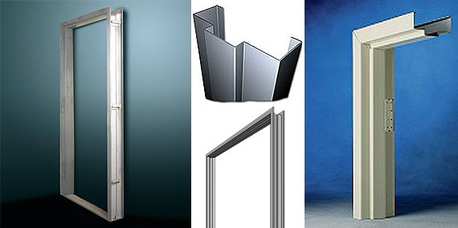
CONTACT US
Contact Person: Mr. Neeraj Sehgal
Mobile No: +91 - 9891139441
Landline No: 011 - 28114613
WORKS: B-133, Mayapuri Industrial Area
City: New Delhi - 110064
State: Delhi

